Slide 1
Game System Topologies Marc LeBlanc

Slide 2
Meaning and Mechanics
Andy Ashcraft
Daniel Cook
Marc LeBlanc
Notes:
Start: 2:40

Slide 3
Where does ‘Meaning’ Come From?
The player’s built-in expectations
Cultures may vary.
Extrinsic and intrinsic rewards
What we do to win tells us what is important.
The fiction:
Labels that we add to stuff in the game.
Notes:
Start: 2:40

Slide 4
What do you mean by ‘Meaning’?
Meaning is what the game is about (if anything)
Meaning is the IDEA that attaches to an event in our minds
Meaning can make us CARE
Notes:
Dan’s story about player’s risking Freezing to death to save people, but not for currency

Slide 5
Games without ‘Meaning’?
Yahtzee, Craps, many sports
Traditional card games
What does it MEAN to win a hand of Poker?
You’re wealthier than you were - stakes!
You’re “good at Poker” (Lucky? Skilled? Cool?)

Slide 6
Players will ADD Meaning
“Last one home’s a rotten egg!”
Increase the stakes
How we play Apples to Apples
Game outcomes can define the player

Slide 7
Dane Cook on Rock-Paper-Scissors
“I understand that Scissors can beat Paper, and I get how Rock can beat Scissors, but there's no f***ing way Paper can beat Rock. … When I play Rock-Paper-Scissors I always choose Rock. Then when somebody claims to have beaten me with their Paper I can punch them in the face with my already clenched fist and say "oh s**t I'm sorry, I thought Paper would protect you, a**hole.”

Slide 8
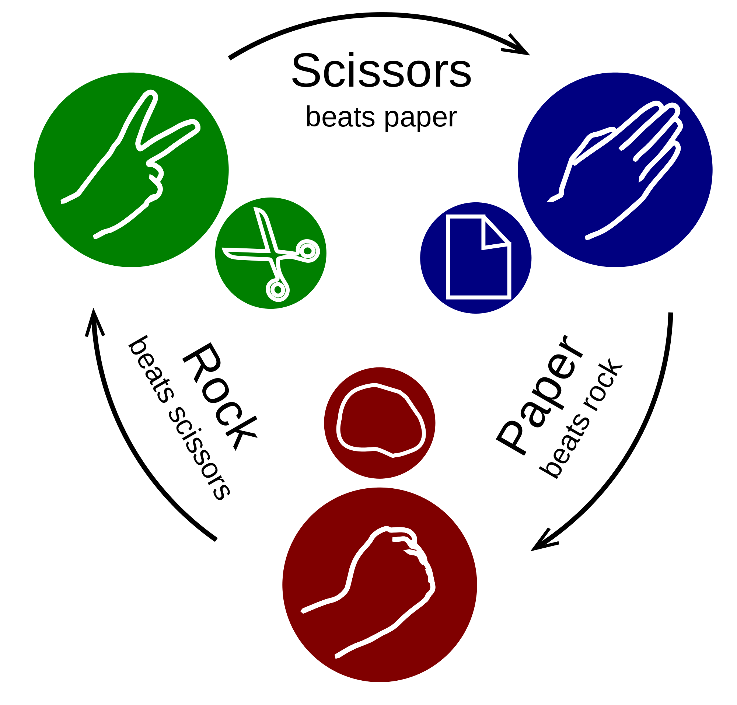
Rock-Paper-Scissors
Lame fiction

Slide 9
Rock-Paper-Scissors
Lame fiction, BUT
Memorable
Simple gestures

Slide 10
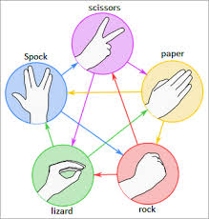
Rock-Paper-Scissors
Lame fiction, BUT
Memorable
Simple gestures
Has been hacked expanded to…

Slide 11
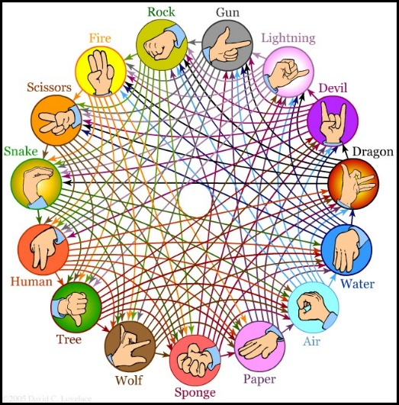
Rock-Paper-Scissors
Or this…
Hilariously complex
Neither Memorable nor Simple
Playable?

Slide 12
Rock-Paper-Scissors
Common mechanic for lots of games:
Punch → Kick → Throw → Punch
Archers → Pikemen → Cavalry → Archers

Slide 13
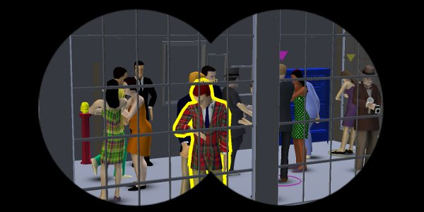
SpyParty by Chris Hecker
Player 1 is a Spy at a cocktail party
Player 2 is a Sniper with one bullet

Slide 14
SpyParty by Chris Hecker
What if Player 2 is an Informant who can just tap the Spy to expose him?
Point and click
Same mechanic, different label
One PLAYS differently

Slide 15
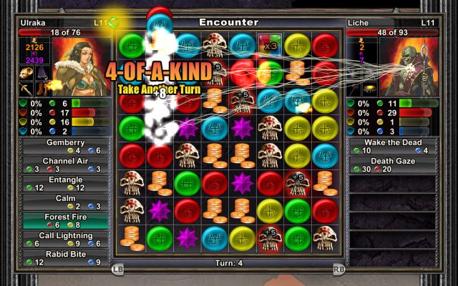
Puzzle Quest by Steve Fawkner
Standard Match-3 style game
Each symbol has a different meaning
Players customize the meaning as they play

Slide 16
Meaning is an Input
Like Code and Story and Hardware
Meaning is controlled by Designers
In MDA terminology: Meaning is another element of a game’s Mechanics.
Notes:
20 minutes

Slide 17
Activity Stage 1 20 min.
4 people per Table per game pack
Play that game until you understand it
Each person should play at least once
Keep track of the choices players make
Keep track of the results of each game
Note the risky Vs. cooperative strategies
Notes:
40 minutes

Slide 18
Activity Stage 2 10 mins
Create a STORY to explain the game
Give meaningless mechanics a meaning
Do NOT change ANY mechanic
DO use the fiction to push or pull players into choosing specific strategies.
Notes:
50 minutes

Slide 19
Beta Test 1 15 mins
2 from each group PLAYTEST other games
STAY & TEACH
‘Kleenex’ Testing (always new players)
Track player choices and outcomes
Data is King!
PLAYTESTERS
Spread out
Play 4 games
Play each game only once!
Track your scores
Notes:
1:05 minutes

Slide 20
Discussion
Teachers: Did it work? Did the Kleenex Testers play differently than you did, pre-fiction?
Playtesters: Could you tell, in one play experience, how the game was pushing you?
What else did you notice?

Slide 21
‘Rational’ & ‘Irrational’ Actors
Game Theory terminology
Optimized Vs. Meaningful strategies
What external factors affect player choices?
Social situation & stakes
Morality
Others?

Slide 22
Types of Players
Are some players harder to ‘move’ away from ‘rational’ strategies?
Hard-core Vs. Casual players
New players Vs. Veterans
Economists? Lawyers? Game Designers?
Game design ‘literacy’?
Notes:
1:15 minutes

Slide 23
Activity Stage 3 5 mins
ITERATE your fiction based on your data
Feel free to try a completely NEW story
Still DO NOT change ANY mechanic
Consider:
Changing the stakes
Non-symmetrical roles
Notes:
1:20 mins

Slide 24
Beta Test 2 15 mins
Playtesters to play 4 NEW games.
STAY & TEACH
Sell it with story!
Kleenex Testing
Track choices and results
Data is King!
PLAYTESTERS
Spread out
Play 4 new games
Play each game once
Track your scores!
Notes:
1:40 mins

Slide 25
From A Theory of Fun – Raph Koster
“Let’s picture a game wherein there is a gas chamber shaped like a well. You the player are dropping innocent Jews down (in) … and they come in all shapes and sizes. … As they fall to the bottom, they grab onto each other and try to… get to the top of the well. Should they manage to get out, the game is over and you lose. But if you pack them in tightly enough, the ones on the bottom succumb to the gas and die.”
Notes:
“Let’s picture a game wherein there is a gas chamber shaped like a well. You the player are dropping innocent Jews down into the gas chamber, and they come in all shapes and sizes. There are old ones and young ones, fat ones and tall ones. As they fall to the bottom, they grab onto each other and try to form human pyramids to get to the top of the well. Should they manage to get out, the game is over and you lose. But if you pack them in tightly enough, the ones on the bottom succumb to the gas and die.
“I do not want to play this game. Do you? Yet it is Tetris. You could have well-proven, stellar game design mechanics applied towards a quite repugnant premise.”

Slide 26
From A Theory of Fun – Raph Koster
“I do not want to play this game. Do you? Yet it is Tetris. You could have well-proven, stellar game design mechanics applied towards a quite repugnant premise.”
There have been (at least) TWO games that have done (almost) exactly this!

Slide 27
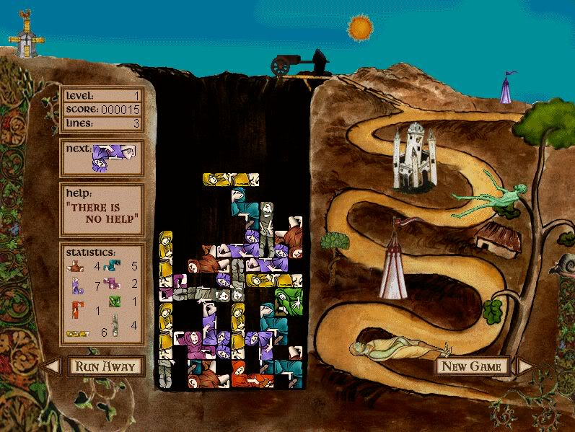
“Dead Drop”
Monty Python’s Quest for the Holy Grail
Lesley Mathieson, 1996
Tetris with Dead Bodies

Slide 28
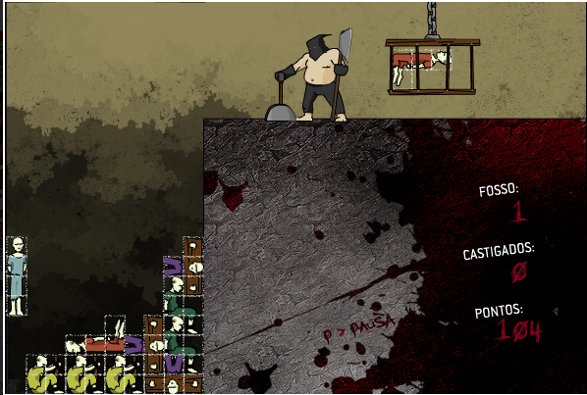
Calabouço Tétrico (Tetric Dungeon)
Raphael Aleixo, 2008
Designed in response to A Theory of Fun
(Koster noted on his website that he found it grimly unappealing, but played it anyway.)
Notes:
Two games can have different aesthetics even while the mechanics are the same.
Everyone expects Monty Python to be funny, but a relatively unknown game designer making a game about dropping bodies in a pit is kinda creepy. (screams were particularly creepy)

Slide 29
The Carrot & The Stick
Fiction can be used to push players away…
OR to draw them in.
Notes:
1:50 mins DANIEL’S FROZEN CHILDREN EXAMPLE.

Slide 30
Activity Stage 4 5 mins
ITERATE based on your data
ONE FINAL CHANGE
Still do not change ANY mechanic
Change ONLY the labels to push players toward non-optimal decisions
DON’T HOLD BACK!
Notes:
2:00 hours

Slide 31
Final Test 15 mins
Send NEW Playtesters to play the games.
STAY & TEACH
SELL the story!
Kleenex Testing
Track player choices and results
Data is King!
PLAYTESTERS
Spread out
Play only new games
Play each game once
Play quickly!
Notes:
2:15 mins

Slide 32
Final Discussion
What effect does the promise of a prize have on the playtesters?
Where there games you did not WANT to play because of the story?
Any final thoughts / observations?

Slide 33
Recap!
Labels and Fiction can change Meaning
Meaning directly affects Dynamics
Tension between meaningful play and optimized (‘rational’) play strategies

Slide 34
Thank You!
Monday –
Everyone return on Tuesday, 10am for DAY 2!
Tuesday -
Everyone return to room 120 at 5:30pm
Q/A and final wrap-Up!
Notes:
2:30 mins

Slide 35
Fin

